Slide 1
Eisenhower Matrix
Contributor: Arseniy Zakharov

Slide 2
Problem Configuring
Lots of people cant manage their time efficiently

Slide 3
What it all about?
A method of time management that helps to isolate the most important and urgent tasks from the entire flow of cases, and distribute the rest of the tasks according to the parameters of speed of their realisation and value. This helps to regulate the workload.
The meaning of the Eisenhower Matrix is mainly to learn how to distribute all your affairs competently, to distinguish the important from the urgent, not urgent from the least important, and also to reduce to the maximum extent possible the time spent on any affairs, the fulfilment of which does not give any significant results.
Defunder: Dwight David Eisenhower

Slide 4
Goals
Tasks
Create an app, which will help its users to use their time more efficiently
Found information on this theme
Develop a connected database
Create an interactive user-friendly interface
Publish it in public

Slide 5
Essential functionality of the application
Main window with responsibility to add tasks to different categories with their personal functions
Window with tasks that have done
Available to edit tasks

Slide 6
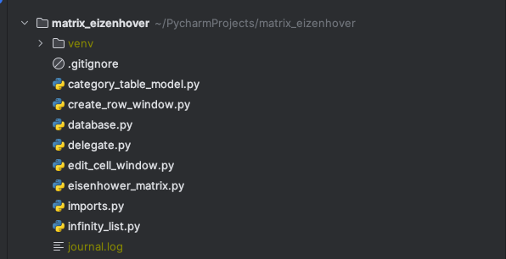
Project classes

Slide 7
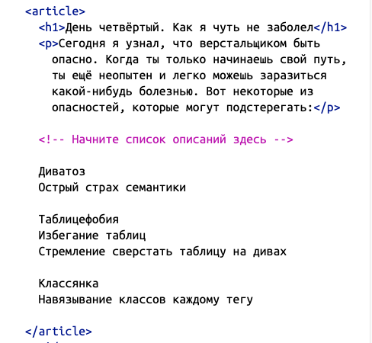
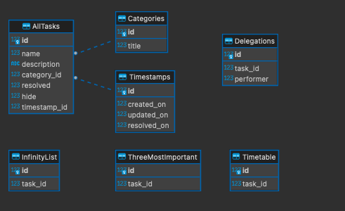
Database Structure
Besides its looking trivial. Data structure still is very interesting

Slide 8
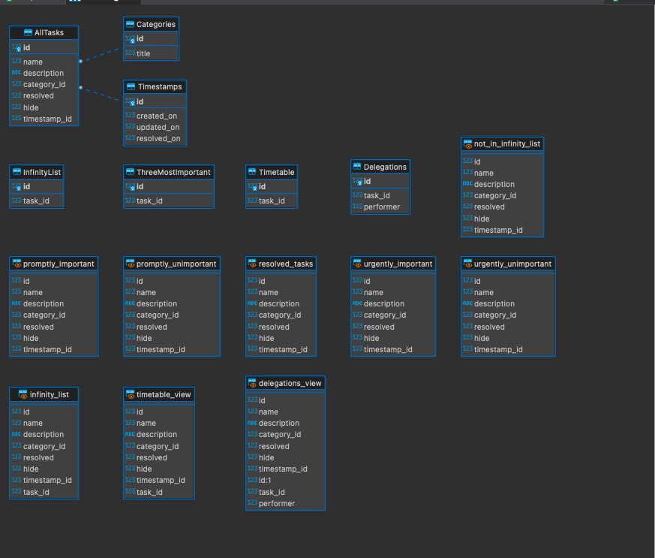
Full
Database
Structure

Slide 9
Future investigations
There's lots of potential for the future!
Make redesign!
Make more features for tasks!
Make an account system!
Make it work with backend server!

Slide 10
My final score
requirements.txt | Несколько форм | Изученные виджеты | Другие виджеты | Стандартные диалоги | Картинки | Файлы txt или csv | Несколько таблиц в БД | Чтение из БД | Запись в БД | Изменение данных в БД | exe
1 | 1 | 1 | 1 | 1 | 1 | 1 | 1 | 1 | 1 | 1 | 1
Amount of code: ~800 rows

